Slide 1
Mentoring Programme of the Ciarb Egypt Branch

Slide 2
Branch Mentoring Programme
Fourth Cycle 2024–2025
4 Mentors, 4 Supporters, and 18 Mentees

Slide 3
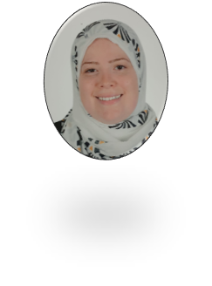
Branch Mentoring Programme Fourth Cycle May 2024 – May 2025
4 Groups Mentored by:
Mentors
Mr. Taher Hozayen
Ms. Rania Koura
Mr. Abdallah El Shehaby
Mr. Sherif El Saadani
Arbitrator & Lawyer -Mackean Law Firm
Partner at Amr & Partners Law Firm,
Head of Arbitration
Partner at Jurisera
Partner at Amereller
Dr. Amira Shalaby
Eng. Mona Mobarez
Ms. Lamyaa Mohamed Saad
Mr. Mahmoud El-Khamry
Mentor
Supporter
Contracts Manager, Hassan Allam Holding
Contacts Manager, AGILE Project, Management Advisors
Chief Prosecutor, Administrative Prosecution Authority (APA)
Partner at Amr & Partners Law Firm

Slide 4
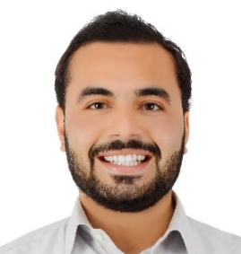
Branch Mentoring Programme Fourth Cycle May 2024 – May 2025
Group 1
Dr. Amira Shalaby
Mentors
Mr. Taher Hozayen
Mentor
Supporter
Contracts Manager, Hassan Allam Holding
Arbitrator & Lawyer -Mackean Law Firm
Mr.
Ahmed Sameh
Mr.
ABDALLA ZAHER
Eng. Mohamed Matar
Eng. Muhammed Abdelwahab
Eng.
Ahmed Samir Ali
Mentees
Judge - State Commissioner, Court of Administrative Judiciary
Junior Lawyer trainee, LEGAM
Contracts and Claims Consultant - MID construction (USA)
Contracts Engineer - Creative Group
Senior Contracts Engineer - Saudi Icon

Slide 5
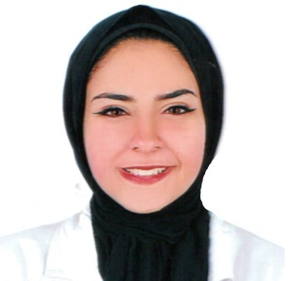
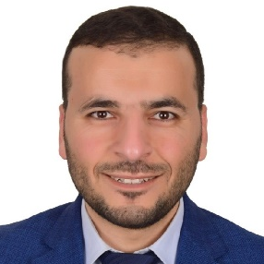
Branch Mentoring Programme Fourth Cycle May 2024 – May 2025
Group 2
Eng. Mona Mobarez
Mentors
Mentor
Supporter
Ms. Rania Koura
Contacts Manager, AGILE Project, Management Advisors
Partner at Amr & Partners Law Firm,
Head of Arbitration
Ms.
HALA EL-BAHR
Mentees
Eng. Mohamed Abd el-Rahman
Eng. Mohammed Ezzat El-Sayyad
Eng. Mohamed H. AbdAllah
Master's Researcher at the Maritime Academy & Corporate Lawyer in statements consulting
Control Engineer, Scope Project Management, American Planning Consultancy
Contracts Manager - Talaat Mostafa Group “TMG”
EDECS Eldawlia for Engineering & Contracting

Slide 6
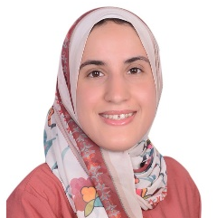
Branch Mentoring Programme Fourth Cycle May 2024 – May 2025
Group 3
Ms. Lamyaa Mohamed Saad
Mentors
Mentor
Supporter
Mr. Abdallah El Shehaby
Chief Prosecutor, Administrative Prosecution Authority (APA)
Partner at Jurisera
Eng.
Mariam Abou Zaid
Eng.
Mohamed Fadl
Eng.
Hossam Meshref
Eng.
Amr Elshamy
Mentees
Senior Contracts Engineer, Agile Project Management Advisors Agile PMA
Contracts Engineer Team Leader - Rowad Modern Engineering
Contracts Administrator - Orascom Construction S.A.E
Contracts Manager - AVIC International Holding Corporation

Slide 7
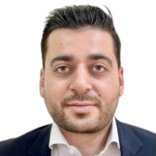
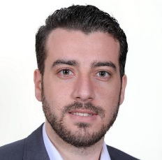
Branch Mentoring Programme Fourth Cycle May 2024 – May 2025
Group 4 (Online)
Mr. Mahmoud El-Khamry
Mentors
Mentor
Supporter
Mr. Sherif El Saadani
Partner at Amr & Partners Law Firm
Partner at Amereller
Mentees
Eng. Shaimaa Shehata
Eng. Ahmed Abdelhameed
Eng. Bashir Sarieddine
Eng. Mohammed Galbat
Eng. Omar Mohamed Lotfy
Senior Contracts Engineer - Agile Project Management Advisors - Dubai
Senior Planning Manager / Project Controls Manager - WTE
Contracts And Claims Specialist - Qatari Diar – Saudi Bin Laden Group
Senior Contracts Engineer - Masco HQ, Mohamed Ali El Swailam Co. for trading and Contracting
Contracts Section Head -Mofrreh Marzouq Al-Harbi & Partners Co. LTD.

Slide 8
Thank You

